Slide 1
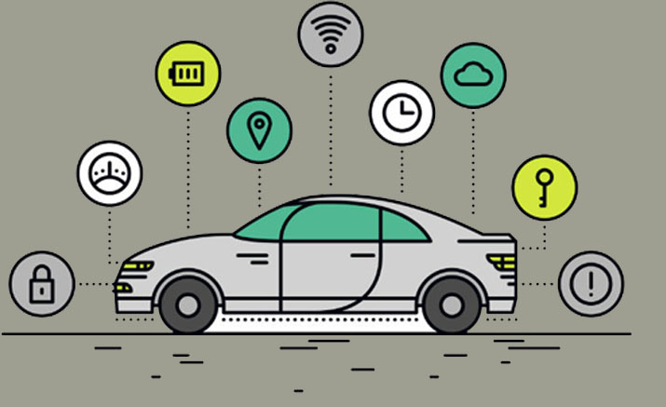
Implementation of Smart Parking System Using Image Processing
PS/2014/002
P.M.D.S Amarasooriya

Slide 2
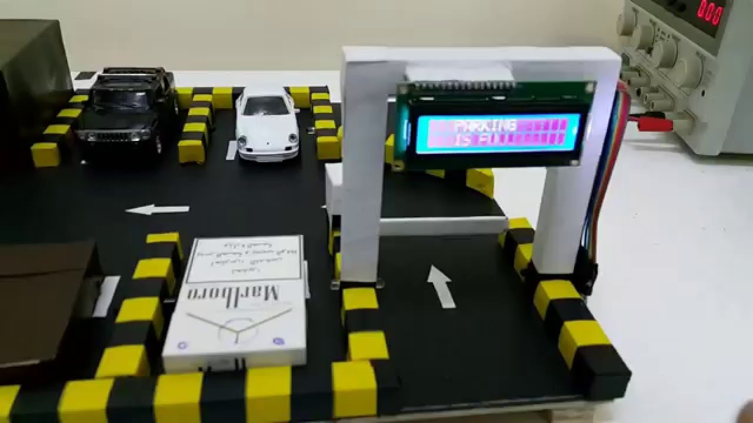
Introduction
Detect whether the parking bays are free or occupied.
Finding a parking space.
To minimize the time spent.
Avoid the collision.
Reducing stress.
Increase in safety.
Notes:
Smart Parking is a parking solution that can include in-ground Parking sensors or cameras. These devices are usually embedded into parking spots or positioned next to them to detect whether parking lots are free or occupied.
To minimize the time spent in searching for the nearest available car parking area.
Smart parking reduces stress while searching for a parking space.
Drivers can park their vehicles in a more efficient way ,because they know exact location to park their vehicle.

Slide 3
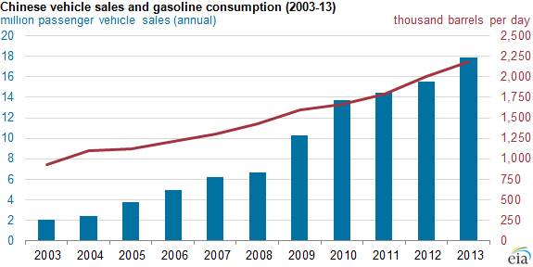
Problems Of Existing Car Parking Systems
High demand.
Difficulty in finding a space to park the vehicle.
Wasting time for searching empty slot.
More fuel consumption
Potential accidents
Figure: total vehicle population in Sri Lanka
Notes:
Nowadays most car parks are inefficiently and most car parking have a manual process in Sri Lanka.
Increasing number of vehicles leads to high demand for parking space.
More fuel consumption while driving around the parking lots leads to high emission of Carbon dioxide.
Potential accidents caused by abundance of moving vehicles.

Slide 4
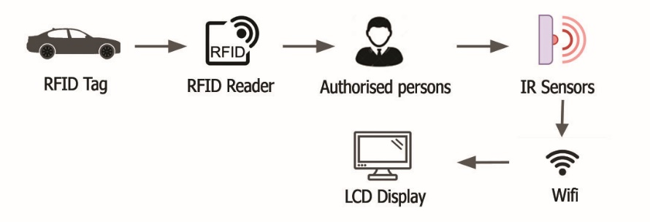
Literature Review
Types of smart parking system
RFID and Internet of Things
Earth’s magnetic field of magnetic sensors
Using image processing technologies
Notes:
using both Radio-Frequency Identification (RFID) and Internet of Thing which can detect the available parking lot. This IOT based parking system is created by using controllers, sensors, servers, and cloud. Sensors will be placed in each parking slot to detect the presence of a vehicle.

Slide 5
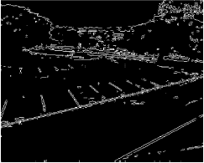
1. IOT based smart parking system using Arduino
Use GSM Module and the infrared sensor.
2. Automatic Parking System using Image Processing
To detect the number plate region and increase the
security.
Use Background subtraction.
Use Canny edge detection.
Notes:
This system is used Background subtraction method for detect the vehicles.
For this there must have high cost.
This system can give incorrect results in bad weather conditions.

Slide 6
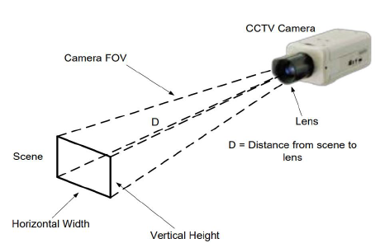
Smart Parking System Using Image Processing
Benefits of the system
Cost reduction of sensors.
Maximizing the coverage area (70 feet*50 feet at a distance of 80 feet).
Easy-installation
Ability to use open-source libraries.
Improved performance.
Notes:
IOT base system is used sensors for every parking slot One camera coverages a large area.
Camera has a coverage area of 70 feet by 52 feet at a distance of 79 feet. Because of that this method is cheaper than IOT base system
Easy-installation because use easy tools and no wiring.
Since open-source libraries are used, open to further improvements if required.
Camera position could be adjusted to improve performances

Slide 7
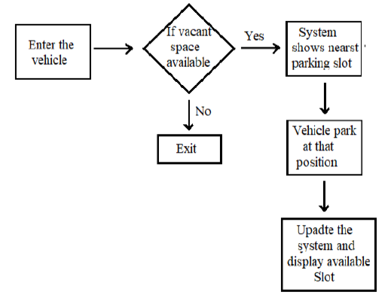
Methodology
Identify the free parking slots
Contains the shortest path algorithm
Camera is acting as a sensor
Ability to detect many vehicles at once
Can identify the vehicle type
Notes:
The proposed method can identify the free parking slots .
The system contains the shortest path algorithm to help drivers in finding the nearest vacant parking space.
To identify the vehicles, use yolov3 object detecting algorithm

Slide 8
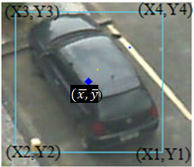
Yolov3 Object Detection Algorithm
Faster than other
Real time working
High accuracy
Can detect different types of vehicles
Mean pixel value
Notes:
Yolo object detection API was used to detect the vehicle.
This algorithm shows high accuracy than canny edge detection method and background subtraction method.
After detecting the vehicle in parking area, get the mean pixel value of each vehicle using boundary coordinates of square.

Slide 9
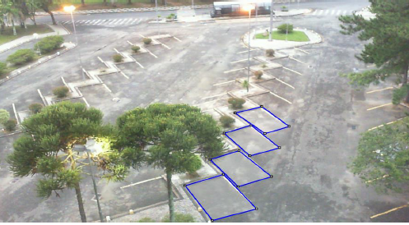
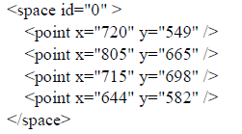
Process
Getting the stream video
Labeling parking slots
Use x and y coordinates
Detecting the vehicle
Getting mean pixel value
Identifying the busy parking slots and free
parking slots
Identifying the nearest parking slot
Notes:
Get stream of video from camera sensor
Mark each parking slots using x and y coordinate when the parking area is empty.
After getting coordinates stores it into XML file. XML file containing the position of each parking space.

Slide 10
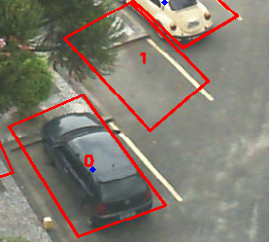
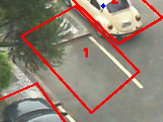
Process
Notes:
The status of each parking slot can be determined by comparing the mean pixel value of each vehicle and the coordinates of bounding boxes. If the mean pixel value of the vehicle is inside the given bounding box then, that parking slot is not empty. Otherwise, it is empty.
For Identify the nearest parking slot Numbering each parking slot is done by considering the distance from the entrance to the parking slot. Then XML file is created according to these numbering.

Slide 11
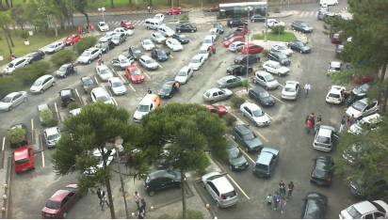
PKLots Dataset
12,417 images of parking lots are included.
Images were taken from different parking lots.
Images show a variety of issues.
Extensible Markup Language file is included.
Notes:
Images were taken from different parking lots presenting distinct features.
Photos are taken under unregulated lighting that depicted various climatic conditions
Images show a variety of issues, such as shadow effect, over-exposure to sunlight, low light in rainy days, the disparity in perspective, etc.

Slide 12
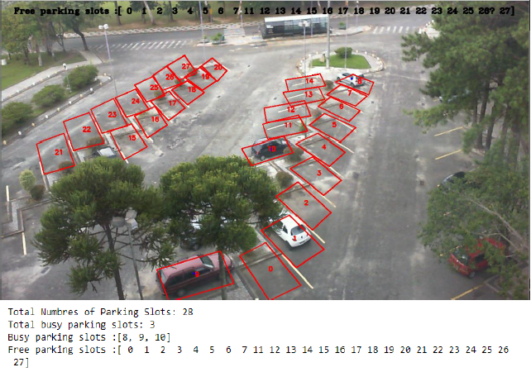
Results
To test the accuracy of the system, used images at different parking areas in various weather conditions.
UFPR04 Area during a cloudy weather condition
Total numbers of parking slots=28
Actual number of vehicles inside the parking slots=4
Detected number of vehicles inside the parking slots=3
Undetected number of vehicles inside the parking slots=1
Percentage Error= 3.571%

Slide 13
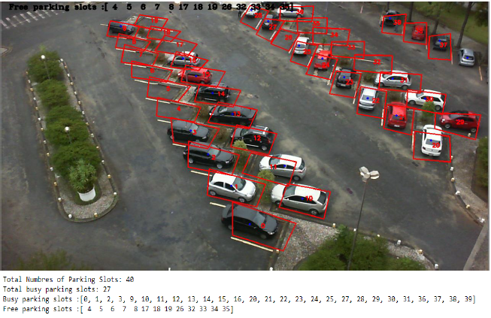
UFPR05 Area during a rainy weather condition
Total numbers of parking slots= 40
Actual number of vehicles inside the parking slots=27
Detected number of vehicles inside the parking slots=27
Undetected number of vehicles inside the parking slots=0
Percentage Error=0
Notes:
Overall percentage of this system is approximately 4%.but there is some limitation.

Slide 14
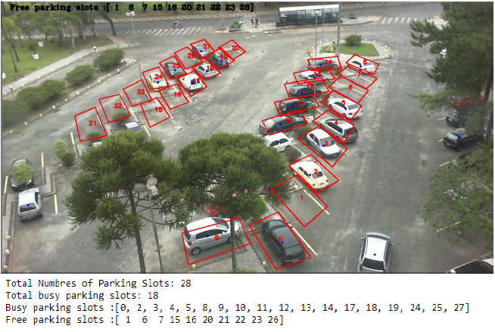
UFPR04 Area during a sunny weather condition
Total numbers of parking slots= 28
Actual number of vehicles inside the parking slots=18
Detected number of vehicles inside the parking slots=18
Undetected number of vehicles inside the parking slots=0
Percentage Error=0
Notes:
Overall percentage of this system is approximately 4%.but there is some limitation.

Slide 15
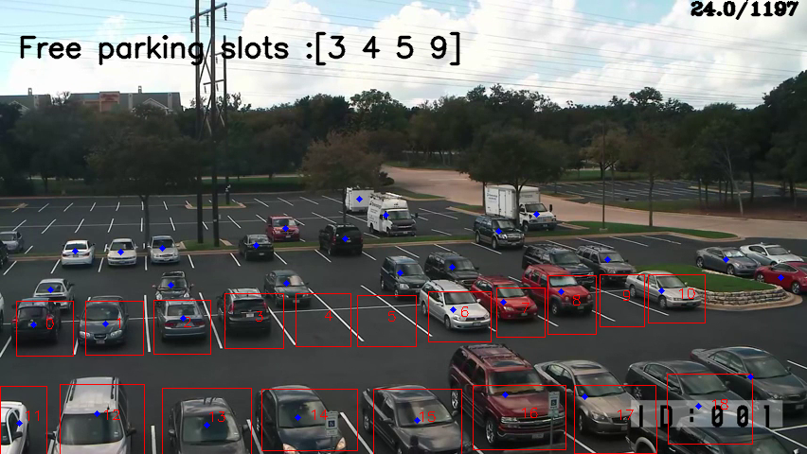
BLK-HDPTZ12 Parking Area
Total number of frames in the video file=1197
Current video frame=24
Total numbers of Parking slots=19
Actual number of vehicles inside the parking slots=16
Detected number of vehicles inside the parking slots=15
Undetected number of vehicles inside the parking slots=1
Percentage Error= 5%
Notes:
Over roll accuracy of this system is 95% approximately. but there is some limitation.

Slide 16
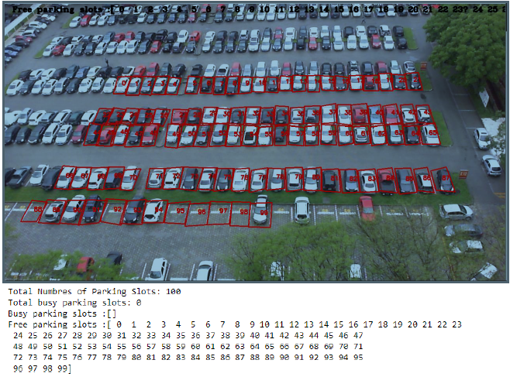
Limitations
When parking area is large, the algorithm fail to detect the vehicles in large parking areas.
Total umbers of Parking slots=100
Actual number of vehicles inside the parking slots=71
Detected number of vehicles inside the parking slots=0
Undetected number of vehicles inside the parking slots=71
Percentage Error= 71%

Slide 17

Limitations
If the parking area is large it is difficult to detect the vehicles.
If the camera position is changed, coordinates should be taken again to create the new XML file.
Camera should be fixed more than ten feet above the ground level.
Should not have obstacles between cameras and parking areas.
Needs more hardware performances to capture the large parking area at once.
Notes:
Because of that the system have to use more cameras.

Slide 18

Conclusion
Optimize the identification of available parking slots.
Capable of managing large areas by just using several cameras.
Reduce the cost of sensors and the wiring hassle.
Drivers can get useful real-time parking lot information.
Notes:
Main contribution is to optimize the identification of available parking slots.

Slide 19
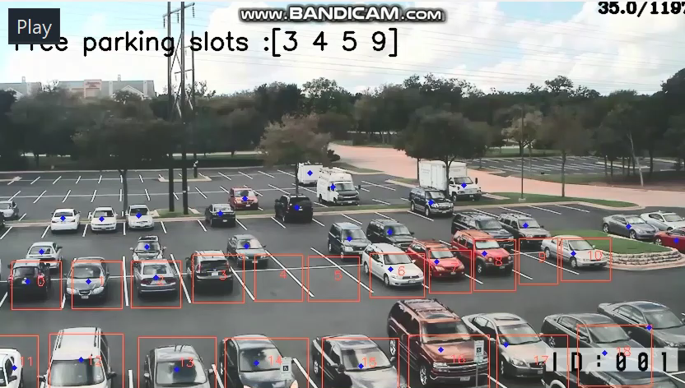
BLK-HDPTZ12 Parking Area

Slide 20
REFERENCES
aayushiedureka. (2019, 11 26). Python NumPy Tutorial – Learn NumPy Arrays With Examples. Retrieved from edureka: https://www.edureka.co/blog/python-numpy-tutorial/
Aekarat Saeliw, W. H. (2019). Smart Car Parking Mobile Application based on RFID and IoT. International Journal of Interactive Mobile Technologies (iJIM), 1-10.
Benjamin Kommey, A. S. (2018). A Smart Image Processing-based System for Parking Space Vacancy Management-J. International Journal of Computer Applications.
Brownlee, J. (2019, 05 27). How to Perform Object Detection With YOLOv3 in Keras. Retrieved from https://machinelearningmastery.com/how-to-perform-object-detection-with-yolov3-in-keras/
DataFlair. (2019, 12 05). Features of Python – Review the irresistible Python attributes. Retrieved from https://data-flair.training/blogs/features-of-python/
Department of motor traffic Srilanka. (2015). Retrieved from http://www.motortraffic.gov.lk/

Slide 21
Thank You!

